Slide 1
                Final Exam
                Student Name:
                Semester:
                Year:

Slide 2
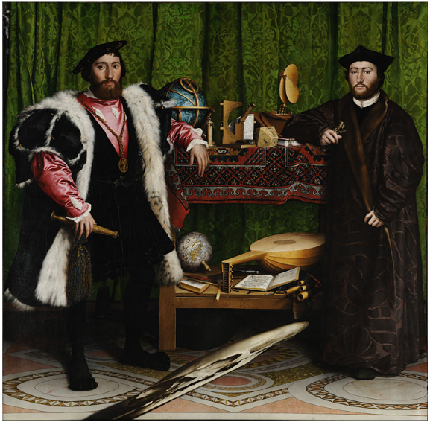
Artwork Description
Artist: Hans Holbein the Younger
Title: The Ambassadors
Medium: Oil on Oak
Date: 1533

Slide 3
Questions about the painting
These men are dressed in luxurious attire, does this mean they are wealthy?
Why the choice of dark clothes?
Does the presence of books indicate the men are literate?
Why is the skull image on the foreground distorted?
Do the instruments on the shelves such as globes, portable sundial and flutes portray the careers of these men?
Why does the man on the right appear gloomy unlike his counterpart on the left?
Why the choice of a plain background?
Does the possession of powerful astronomical instruments such as celestial globe and the sundial lead to gaining of wealth and power?
Why the choice of a red coat on the man on the left?
There is a small crucifix at the top left corner of the painting, does this show Christianity as the recognized religion?
Why are most of the instruments not properly arranged?
Is the object held by the man on the left an instrument of power?
Why the choice of deep focus on the entire painting?
Does the broken lute string show a form of discord?
The man on the right is dressed in religious attire while the one on the left is dressed in contemporary expensive attire, does this symbolize an attempt to harmonize the two sections of the community?

Slide 4
Fiction Story
The painting depicts a time when the religious and secular sections are in disharmony. There is need to bring the two sections together. This drives the religious and political leaders to come together and solve the existing issues. The man on the right (a religious leader) visits the wealthy man on the left, who is political leader.
The two are both educated and influential men. They have powerful instruments that add onto their influence in the community. The presence of astronomical instruments such as globes and the sundial shows the power that political leaders have while instruments like the lute and hymn book represents religion. However, there is a clear distinction between the secular leaders and the religious leaders. In this painting, the man on the left is dressed in expensive, highly polished clothes, while the man on the right is dressed in simple plain clothes. A closer look at this painting reveals that the religious leader does not occupy as much space as his counterpart in the frame. The political leaders possess most of the wealth and power.
This painting portrays a sense of demeaning of religion by the political elite. A very tiny religious sculpture is placed at a barely recognizable place. The religious leaders are also intimidated in the presence of the political leaders as shown here where the religious leader is standing in a less assertive posture and has gloomy face. The use of bright colors in this indoor setting is an attempt to make peace but the two parties are not in agreement.

Slide 5
Summary
This painting honors two powerful, wealthy and educated young men. On the left stands Jean De Dinteville, England’s French ambassador in 1533 and on the right is Georges de Selve, a Lavaur bishop and the Emperor’s ambassador, Venetian Republic. The literate men possess instruments and books, images of power. The distorted skull image in the foreground is a morality symbol.

Slide 6
Evaluation
This painting shows an attempt to bring together the religious and secular worlds, being facilitated by the respective leaders. The disagreement is however not solved eventually as illustrated by the dissatisfied face of the religious leader and the broken lute string. The distorted image of a human skull signifies the inevitability of death, which is in this case the discord between the religious and secular groups.

